Slide 1

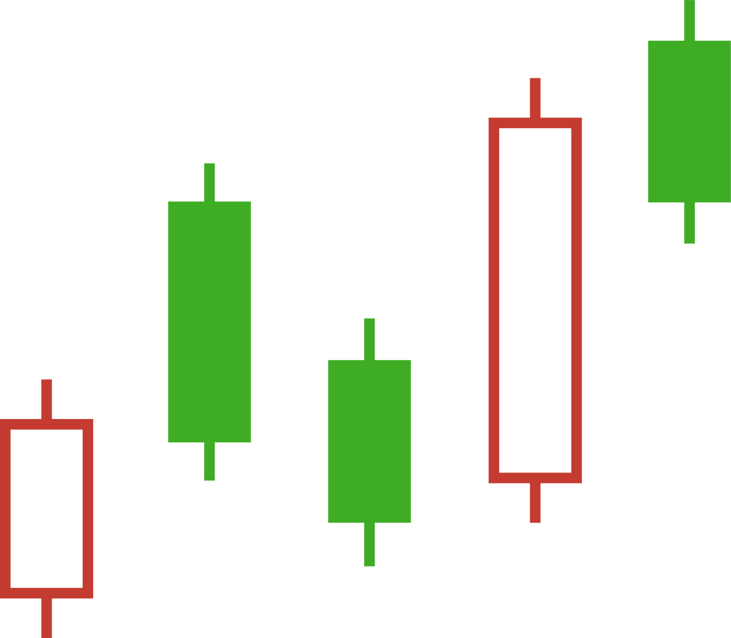
Stock Market
& Cryptocurrency
Sarahana Lal

Slide 2



What is the Stock Market?
The stock market is a financial system where individuals and organizations can buy and sell ownership shares in businesses. These ownership units are known as "stocks" or "shares." When someone buys a share, they are essentially purchasing a small piece of that company, with the potential to benefit from its growth and success.

Slide 3

Introduction to the Magic Band Indicator
The Magic Band is an active graphic aid for trend direction determination, for determining levels for possible support and resistance, as well as levels for breakouts or reversals.
It is made up of several bands that vary in contracted and expanded measures depending on the volatility of the markets.
The price actions of traders are based on observations of interaction between the price levels of the upper and lower bands.
Breakouts that happen above and below the bands can lead to major price actions, and touches may represent possible reversals.

Slide 4
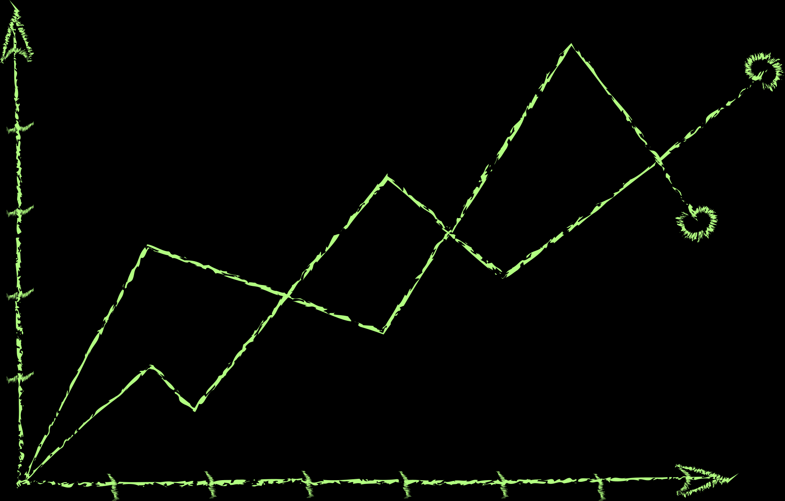

Understanding the Relative Strength Index (RSI)
The RSI is a momentum oscillator that measures the speed and change of price movements and oscillates between zero and 100.
A reading of the RSI above 70 suggests an overbought condition and could be interpreted as a sign that the asset is ripe for a price correction.
On the other hand, if the RSI falls below 30, this points to an oversold condition, meaning the asset is undervalued and due for a bounce.
RSI also finds its application in affirming entry signals and preventing a possible fake breakout when applied together with other indicators.

Slide 5
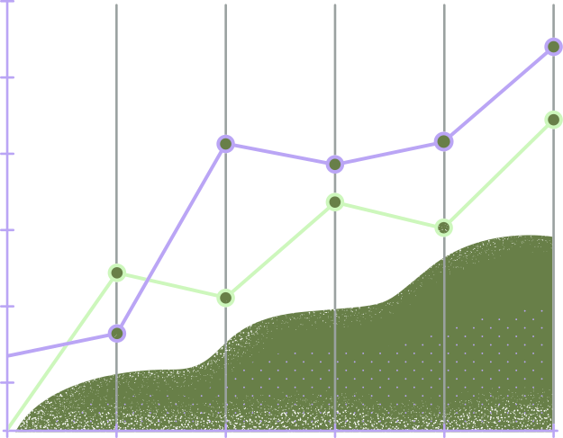
Fibonacci Extensions for Target Levels
What are Fibonacci Extensions?
Fibonacci Extension Levels can be considered a tool of technical analysis, which helps predict potential targets for a price movement by making use of the Fibonacci sequence.
Key Levels
The levels that can be employed in the Fibonacci ratio calculation may include 1.272,
These levels are based on mathematical relationships existing within the Fibonacci sequence.
Strategic Application
These extensions are utilized by traders to determine profit targets after the asset price has broken through its former high or low, particularly after a evident retracement.

Slide 6
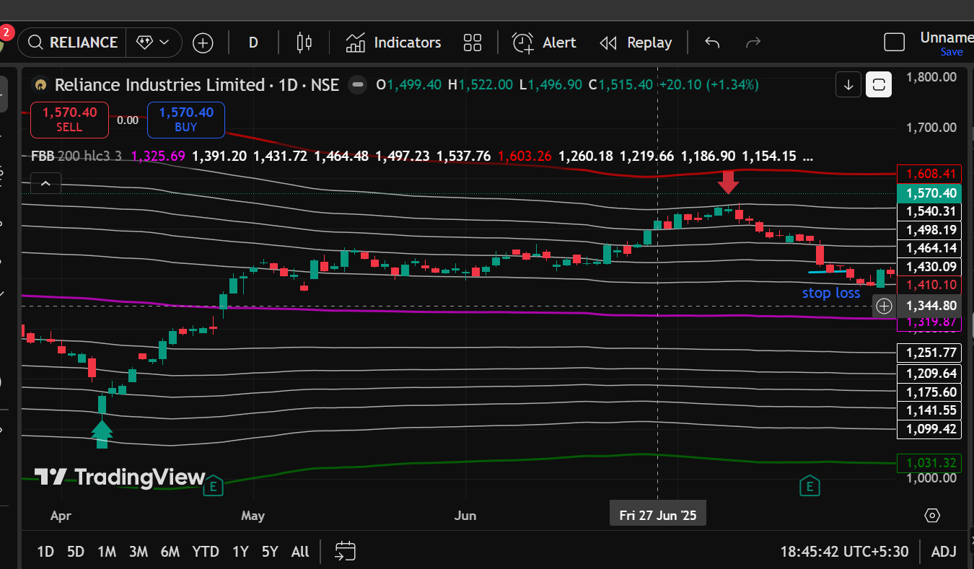
STOCK 1 : RELIANCE INDUSTRIES LTD.
Entry ?
Entry was taken when the price moved above the Magic Band support with RSI confirming bullish momentum
To Avoid Debt:
Exit?
Exit was planned near the upper Magic Band and Fibonacci extension level to book profits after trend exhaustion.
Stop Loss?
Stop loss was placed below the recent swing low and key support level to limit downside risk.
Tools like fibonacci bollinger band, RSI and magic band were applied to determine the marks.

Slide 7
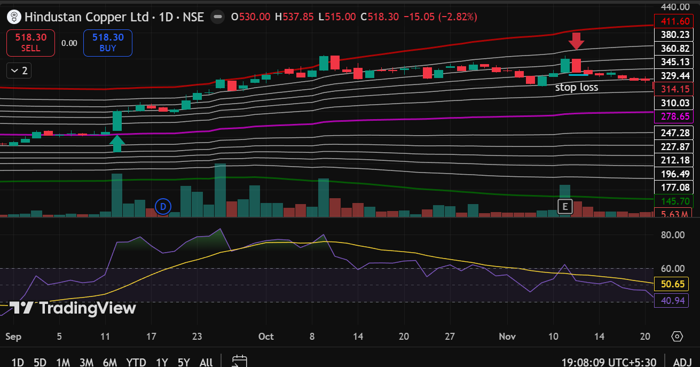
STOCK 2 : HINDUSTAN COPPER LTD.
Entry ?
Entry was taken near Magic Band support as RSI stayed above 50, confirming bullish continuation.
Exit?
Exit was planned near the upper Magic Band and resistance zone to book profits after price extension.
Stop Loss?
Stop loss was placed below the recent swing low and key support level to control downside risk.
Tools like fibonacci bollinger band, RSI and magic band were applied to determine the marks.

Slide 8

STRATEGY SUMMARY
WHY ENTRY
Entry was taken when the price respected the Magic Band support and showed continuation in the prevailing uptrend. The RSI staying above 50 confirmed bullish momentum and reduced the chances of a false entry.
This strategy combines Magic Band to identify trend direction, RSI to confirm momentum, and Fibonacci/price resistance levels to define profit targets. Entries are taken only when price respects Magic Band support and RSI confirms strength, reducing false signals. Stop loss is placed below the recent swing low to control risk, while targets are set near the upper Magic Band or Fibonacci extension zones to ensure a favorable risk–reward. Overall, the strategy emphasizes trend-following with disciplined risk management.
HOW STOP LOSS?
Stop loss was placed below the recent swing low and key support level, ensuring controlled risk. A breakdown below this level would invalidate the bullish setup, making it a logical point for risk management.
How target is selected?
Targets were selected near the upper Magic Band and Fibonacci extension/resistance levels, where price exhaustion is commonly observed. This helped ensure a favorable risk–reward ratio while booking profits after an extended move.

Slide 9
RISK MANAGEMENT
Risk management is the process of identifying, analyzing, and controlling potential risks that may negatively affect a project or business. Effective risk management helps in reducing losses and improving decision-making.
Risk management focuses on identifying and controlling potential risks in a project or business.
RPS
The Risk Priority Score (RPS) is a quantitative measure used to determine the seriousness of a risk by combining its likelihood and impact. It is calculated using the formula:
RPS = Likelihood × Impact
A higher RPS value indicates a higher-priority risk that requires immediate attention, while lower values represent risks that can be monitored or managed with basic controls.
RPT
The Risk Probability Table (RPT) is a tool used in risk management to assess the likelihood or probability of different risks occurring in a project or business. Each risk is assigned a probability value, usually on a scale of 1 to 5, where 1 represents very low chance and 5 represents very high chance. RPT helps in systematically identifying risks and understanding how frequently they may occur.

Slide 10

TYPES OF RISK
Market Volatility
Poor Risk Management
Emotional Decision Making
Technical Indicator Failure
Incorrect Entry Timing
Sudden News or Events
Liquidity Risk
Overleveraging
Internet/System Failure
Regulatory Changes

Slide 11
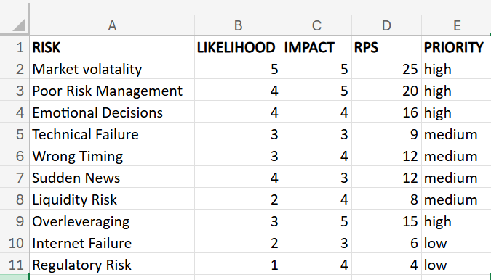
RPT & RPS Analysis Table
(RPT)
RPS =
RPT*IMPACT

Slide 12
CONCLUSION
  Technical indicators like the Magic Band and RSI help traders identify trend directions, support/resistance levels, and momentum for informed decision-making.
  Fibonacci extensions and resistance levels are useful in setting realistic profit targets and exit points.
  Entries should be taken when price respects Magic Band support and RSI confirms bullish momentum, reducing the risk of false signals.
  Stop losses are crucial to minimize potential losses, placed below swing lows or key support levels.
  Combining Magic Band, RSI, and Fibonacci levels creates a disciplined trend-following strategy with controlled risk and favorable risk-reward ratios.
  Risk management is essential for minimizing losses, analyzing potential risks, and making better investment decisions.
  Overall, a structured approach using technical tools and risk management can improve trading outcomes in both stocks and cryptocurrencies.

Slide 13

Thank You

